Slide 1
Identifying Potential Talent Shortage Signals from Job Posting Data
DSAI 3F | Team 4
Module 1 Project
A DuckDB + Streamlit prototype for workforce planning and career-coaching insights

Slide 2
Problem, Target Users & Value Proposition
Problems observed
High hiring demand does not always mean strong applicant interest
Some job categories may have many postings or vacancies, but relatively fewer applications or views
This may point to hiring friction, unattractive roles, skills mismatch, or emerging talent shortages.
Who faces these problems?
Career coaches
WSG/MOM workforce planners
HR/recruitment analysts
Intended Outcome for this project
Identify job categories where demand is high but applicant engagement appears weak
Value Proposition:
Having a dashboard helps users compare job demand, applicant interest, and salary attractiveness to support workforce planning, career guidance, and hiring strategy

Slide 3
Data and Development Flow
Raw CSV
create_database.py
jobs.duckdb
Create Views for analysis
query_database.ipynb
Streamlit dashboard: app.py
SG job posting data
Loads CSV, cleans fields, parses categories, and creates database tables
Stores clean relational tables produced by create_database.py
vw_career_coach_jobs: dashboard-ready joined view vw_talent_shortage_categories: category-level shortage summary
Exploratory SQL analysis and insight generation
Interactive Streamlit dashboard with filters, tables, charts, and score logic

Slide 4
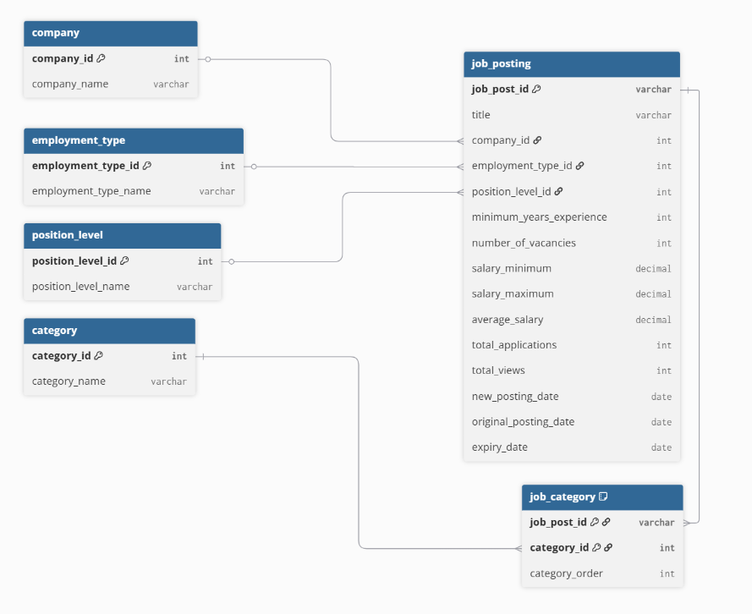
Data Model: From Raw CSV to Analysis-Ready Tables
Key design choices:
The raw CSV contained multi-valued category data, where a job posting can belong to multiple categories, so we used job_category as a bridge table between job_posting and category
category table Stores each category once
job_category table -> bridging table Acts as the bridge table between job_posting and category, because one job posting can belong to multiple categories
Views allow the dashboard to query clean, analysis-ready data instead of repeatedly joining raw tables
vw_talent_shortage_categories
vw_talent_shortage_categories A category-level view for demand, applications, views, and salary metrics
vw_career_coach_jobs A joined analysis view used by the dashboard .
vw_career_coach_jobs

Slide 5
Talent Shortage Signal Logic
Demand
Total job postings
Total vacancies
Applicant Interest
Applications per vacancy
Views per posting
Salary Context
Median average salary¹
Scoring Logic²
Demand Score = 50% Job Posting Demand Score + 50% Vacancy Demand Score
Weak Interest Score³ = 70% Low Application Score + 30% Low View Score
Talent Shortage Signal Score = 60% Demand Score+ 40% Weak Interest Score
1. Median average salary is used as supporting context to interpret whether weak interest may be linked to salary attractiveness or skills mismatch 2. Prototype weighting for explainable scoring 3. Applications are weighted more heavily because applying is a stronger signal than viewing
Key notes:
Scores are indicative and are proxy signals, not proof of an actual labour shortage
Salary is used as context
High demand + weak interest + low salary may suggest role unattractiveness
High demand + weak interest + high salary may suggest skills mismatch or scarce talent
Notes:
A higher Demand Score means stronger job posting and vacancy volume. A higher Weak Interest Score means weaker applicant response, based on lower applications per vacancy and lower views per posting. A higher Talent Shortage Signal Score combines both signals.
A higher Talent Shortage Signal Score means the category ranks higher on the combination of demand and weaker applicant response.

Slide 6
Some key learnings/challenges
Messy real-world data needs modelling before dashboarding
The categories field was multi-valued and required parsing before it could be analysed properly
Many-to-many relationships matter
A job posting can belong to multiple categories, so we needed a job_category bridge table
Views simplify analysis
vw_career_coach_jobs and vw_talent_shortage_categories made the dashboard easier to query and maintain
Streamlit reruns from top to bottom
The dashboard filters change SQL queries, which refresh the DataFrames, tables, and charts
Metrics need careful interpretation
The talent shortage score is useful as a signal, but it should not be treated as confirmed labour market truth

Slide 7
Demonstration
Show Talent Shortage Signals tab
Adjust global filters
Explain how the score changes
Compare with Market Demand and Salary Ranges
Show how this supports workforce planning or coaching discussion
Notes:
How to Read the Talent Shortage Signal Category A: High vacancies + low applications per vacancy + low salary → possible under-attractive sector Category B: High vacancies + low applications per vacancy + high salary → possible skills mismatch or specialised talent shortage Category C: High applications per vacancy → stronger applicant interest relative to demand
→ less likely to be a shortage signal
The SQL helper function centralises database access.
Each dashboard query is passed into run_query(), which opens DuckDB in read-only mode, executes the SQL, converts the result into a DataFrame, closes the connection, and returns the result to Streamlit. T
his keeps the dashboard code cleaner and avoids repeating database connection logic in every tab.

